Slide 1

GymBuddy
Teona Ristova, Vlad Cherevkov, Mikołaj Dębicki

Slide 2
PROBLEM & GATHERING REQUIREMENTS
People know how much they should sleep but they don’t do it
High cost of personal trainers
Effort to search up your own workout
Always with the end user in mind:
Performed 12 interviews with NYUAD students
Performed 2 interviews with NYUAD fitness center staff

Slide 3
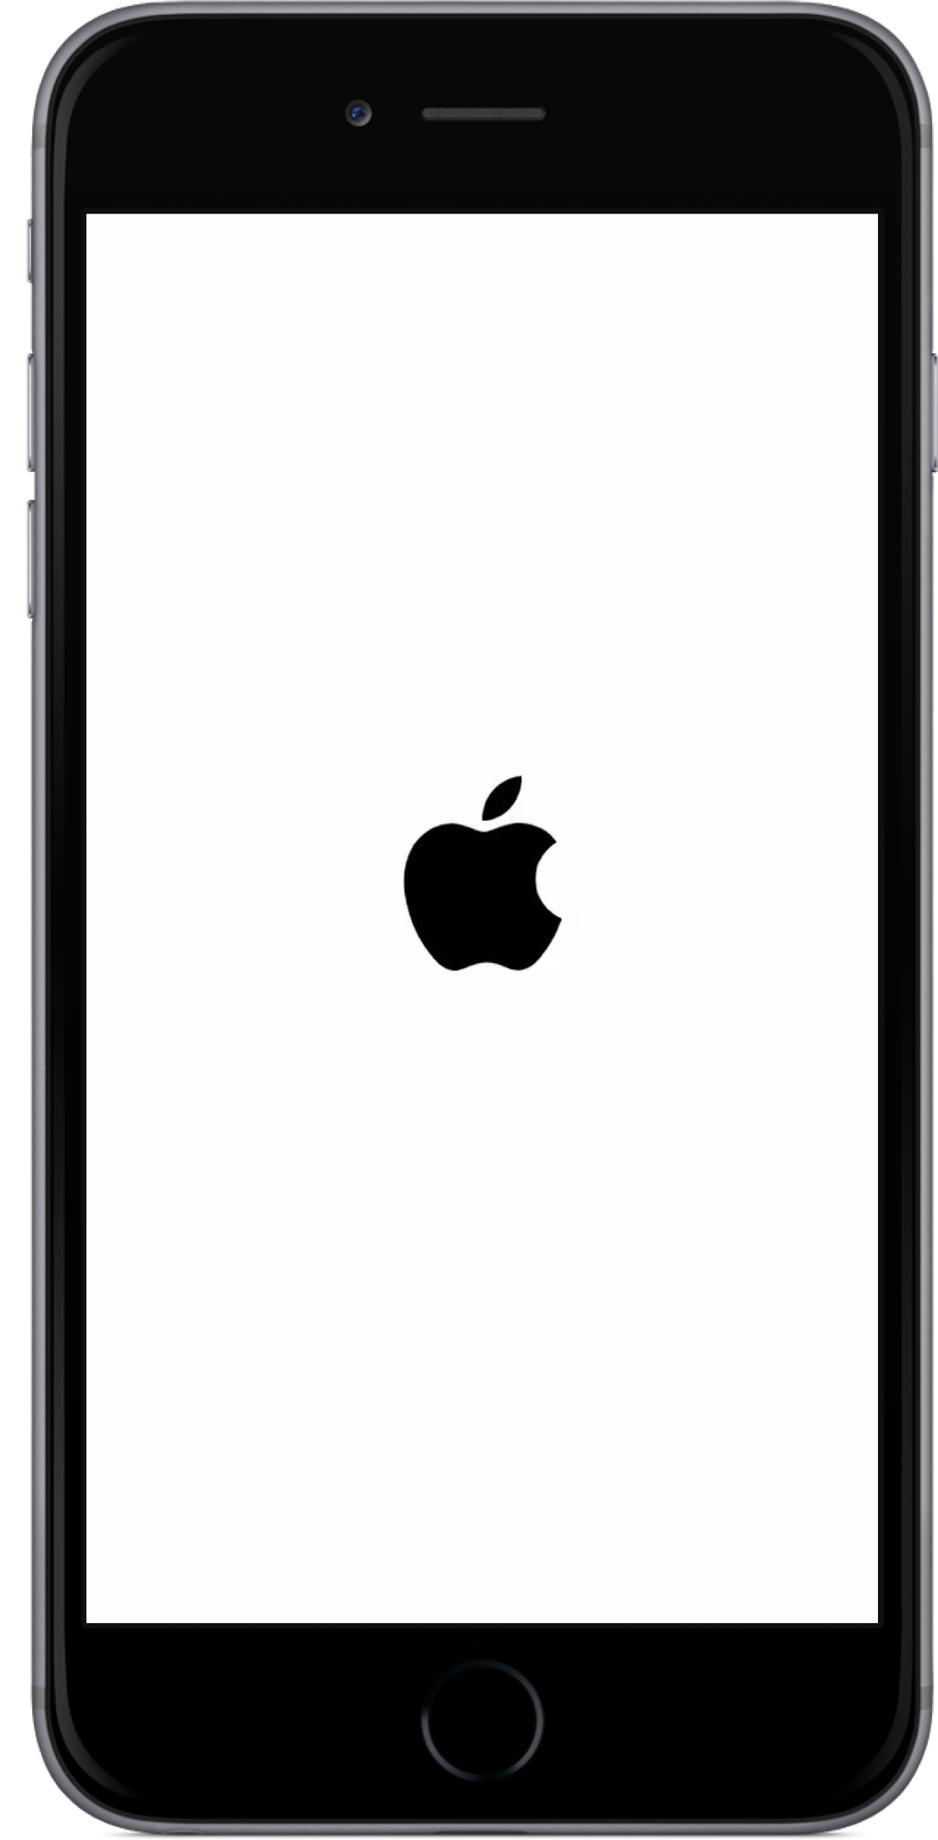

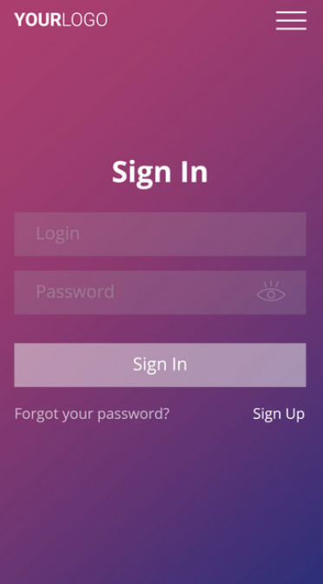
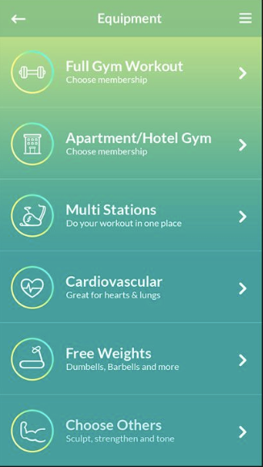
SOLUTION
Handy easy to use app that will help you reach your health & fitness goals
Get workouts according to your skill level & targeted muscle group
Strategy: Free Membership to acquire network

Slide 4


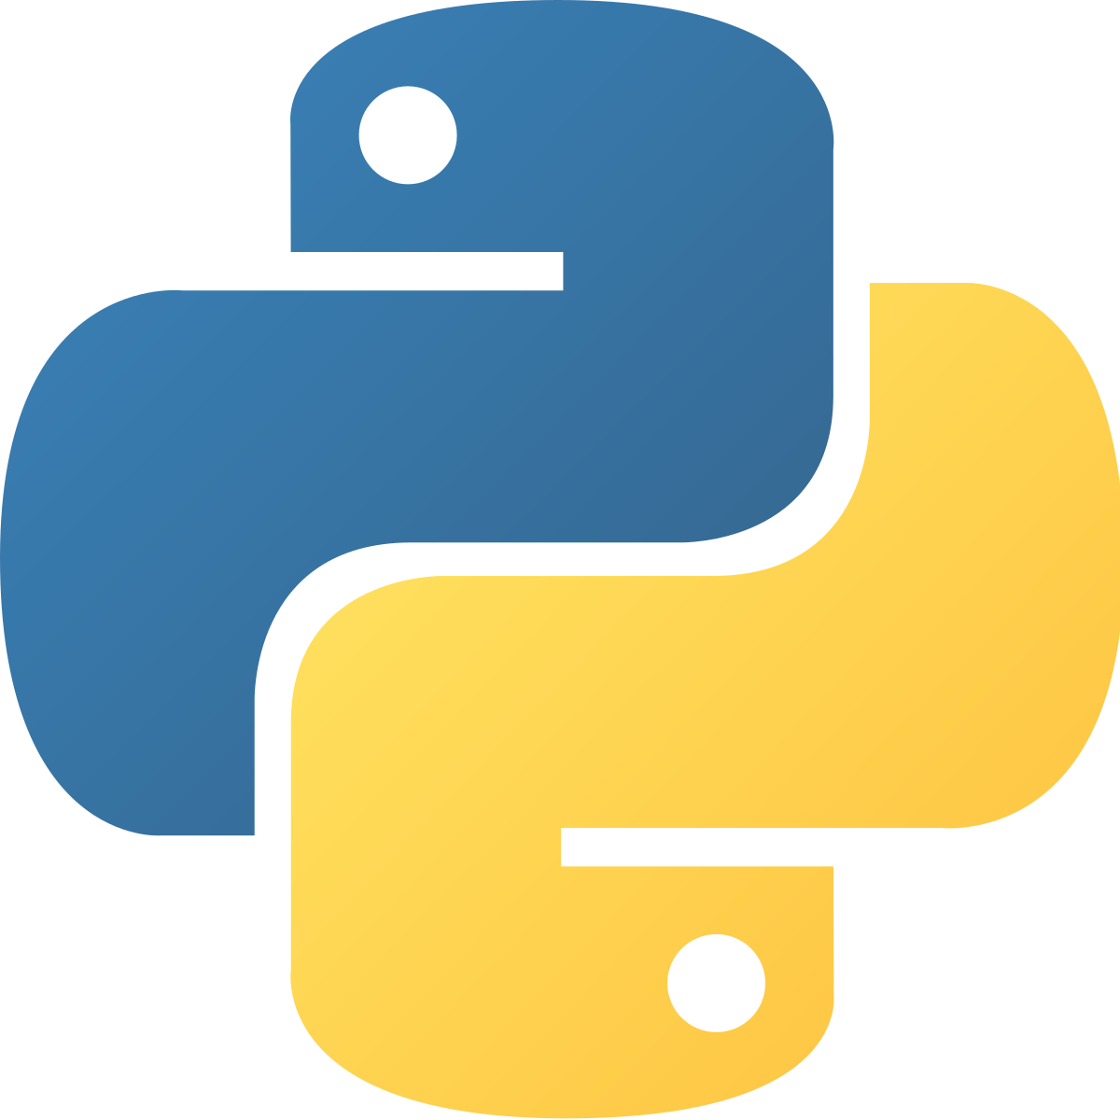


IMPLEMENTATION
Database MAMP, MySQL, and PHPMyAdmin,
Programming language: Python
Process Model: Agile (Scrum)
For now Terminal based

Slide 5
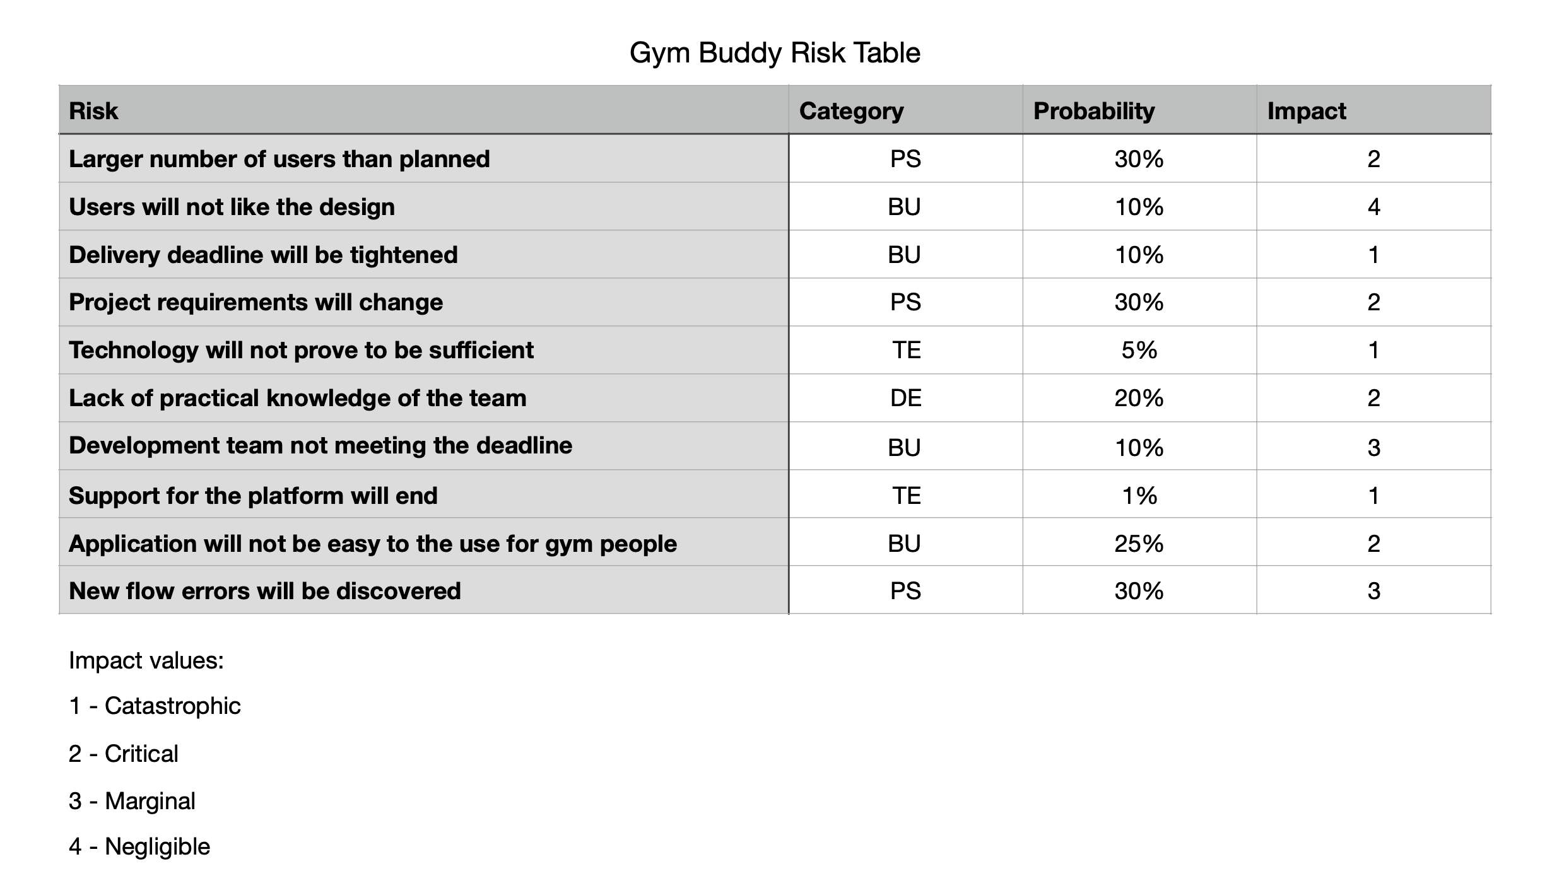
Possible risks

Slide 6

OBSTACLES
Several bugs discovered and fixed during testing
Database implementation took longer than expected
The design of the database was changed - primary and foreign keys
Class diagram had to be modified for better performance: (workout class > exercise class )

Slide 7
DEMO O’CLOCK

